Slide 1

Stock Price Prediction
Using Machine Learning
A Blend of Sentiment Analysis, LSTM, and ARIMA
Presented by: Shivam Kansara, Northwood University

Slide 2

Introduction
Investment Strategies
Traditional Models
AI Advancements
Sentiment Analysis
ARIMA is widely used.
Deep learning models like LSTM.
Enhances prediction accuracy.
Crucial for optimizing returns.

Slide 3

Research Objective
1
Predict JPM Stock Prices
2
Hybrid Model
Integrate sentiment, LSTM, and ARIMA.
Accurately forecast daily prices.
3
Evaluate Sentiment Impact
Assess news sentiment on stock performance.

Slide 4




Literature Review
ARIMA Effectiveness
LSTM Excellence
Sentiment Analysis Insights
Captures linear patterns in time series data.
Excels in capturing nonlinear trends.
Provides insights into market mood.

Slide 5

Methodology - Data Collection
1
Historical Data
Alpha Vantage (1999 - 2025).
2
News Data
NewsAPI for sentiment analysis.
3
Data Conversion
Datetime format.
4
Normalization
MinMax Scaler for LSTM.

Slide 6
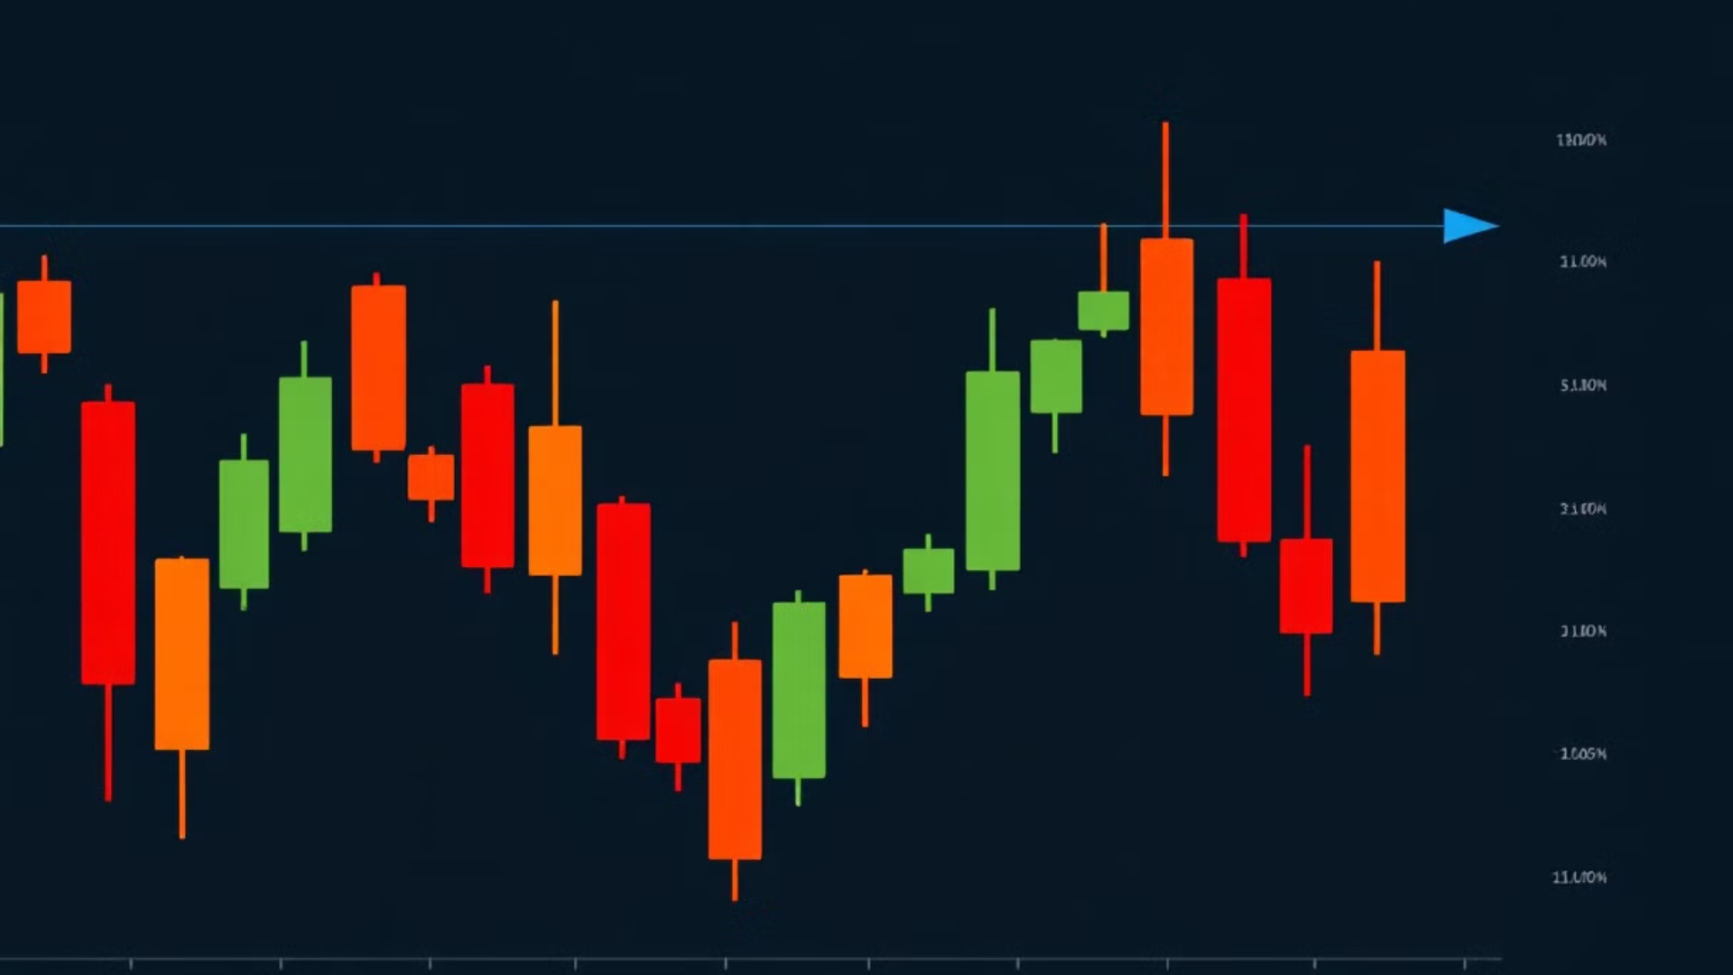



Methodology - Sentiment Analysis
VADER
Weighted Impact
Integration
Sentiment scores calculation.
On stock price predictions.
Enhanced forecasting via LSTM.

Slide 7



Working of LSTM, ARIMA and Hybrid Model
LSTM Dependencies
ARIMA Trends
2
Epochs: 20, batch size: 32.
Parameters: p=10, d=2, q=0.
1
Hybrid model
3
news and reports, integration in LSTM forecasting.

Slide 8

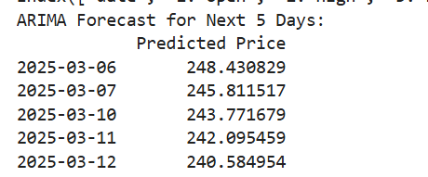
Results - ARIMA Model
Price prediction based on trends.
Reliable Accuracy
-RMSE = 3.21
Struggles with news influence
ARIMA is less accurate when there are rapid price fluctuations.

Slide 9
Result Interpretation:
Short term prediction on the basis of past trends.
Prediction in the range of ±$3.21, which is acceptable.
Struggled with fetching real time news data.

Slide 10
Results - LSTM Model
1
Long-term dependencies
Performance
2
RMSE = 3.2172 and R² = 0.9932
Adaptability
3
To market changes
LSTM is more adept at understanding sudden market changes.

Slide 11
Result Interpretation:
RMSE: Root Mean Square Error
RMSE Value
Model Performance
Close to 0
Very accurate model
Low (<5% of actual price)
Good model
High (>10% of actual price)
Poor model (needs improvement)
Example:
RMSE = 3.21, it means the model’s predicted stock prices are on average ±$3.21 away from actual prices.
If the stock price is around $150, then 3.21/150 ≈ 2.3% error, which is acceptable.
But if RMSE is $15 or more, the model is too inaccurate.
R²
1.0 → Perfect model (100% variance explained).
0.0 → Model is no better than predicting the average stock price.
Negative R² → Model performs worse than a simple mean prediction.

Slide 12
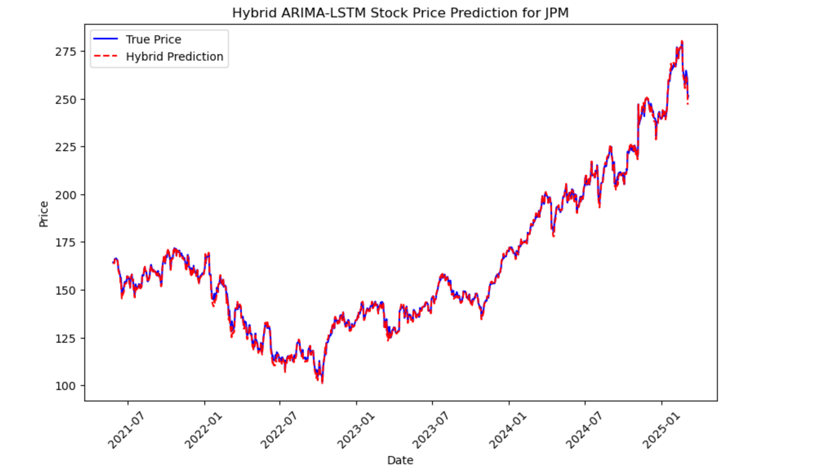
Hybrid stock price prediction for JPM.
Result Interpretation:
Short term prediction on the basis of past trends.
Prediction in the range of ±$3.21, which is acceptable.
Struggled with fetching real time news data.

Slide 13
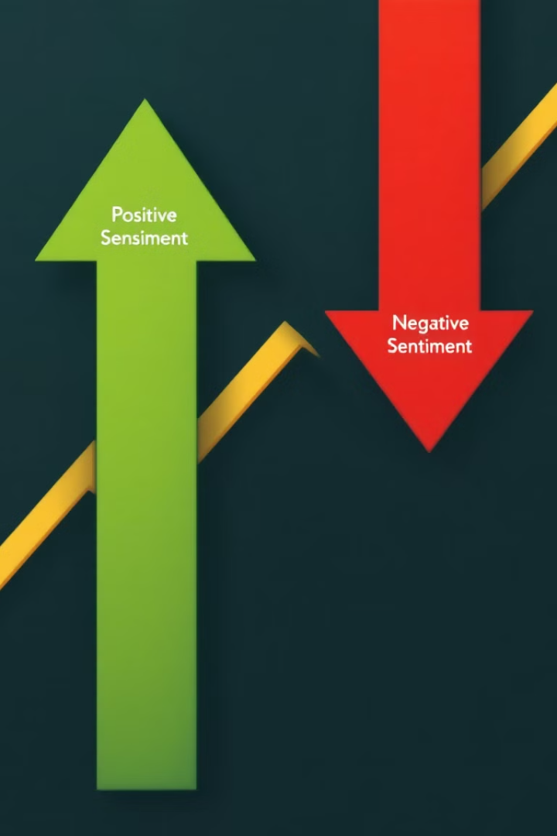
Results - Sentiment Analysis Impact
Negative Sentiment
Stock Declines
Positive Sentiment
Slight Price Increases
Hybrid Model
Improved Accuracy

Slide 14
Comparison of ARIMA vs. LSTM
Model | Results | Strengths | Weaknesses
ARIMA | RMSE= 3.12 R² = -6.1557 | Captures trends, seasonality, and moving averages effectively | Struggles with sudden market fluctuations and non-linearity
LSTM | RMSE = 3.12 R² = 0.9932 | Learns complex patterns, adapts dynamically, and integrates sentiment analysis | Requires large datasets, high computational power
Key Observations:
ARIMA is suitable for stable market conditions with clear trends.
LSTM is preferred for volatile markets and capturing non-linear dependencies.

Slide 15

Future Improvements
Considering adjusted closing price instead of closing price will increase the accuracy.
Integration of different models can improve the accuracy. (SVMD - LSTM) [Agarwal, S, 2025]

Slide 16
Conclusion
Machine learning improves stock price prediction.
LSTM with sentiment analysis outperforms ARIMA alone.
Hybrid models provide a competitive advantage for investors and analysts.

Slide 17

Thank you!

